Slide 1
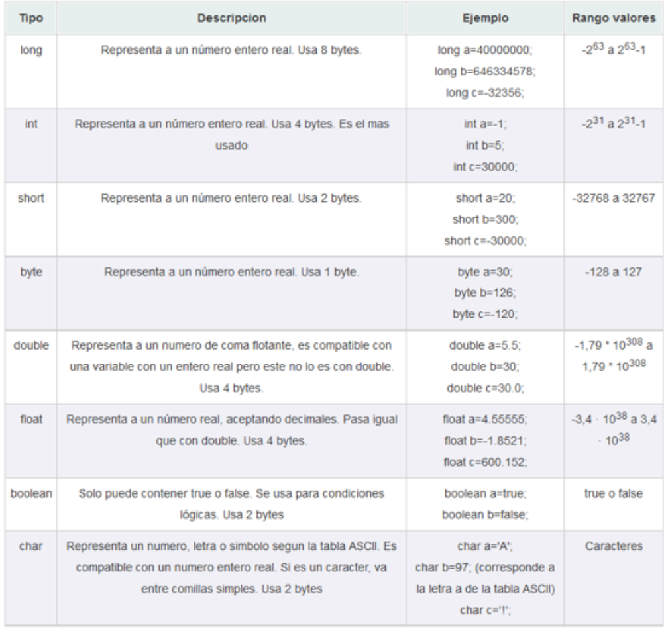
JAVA - ECLIPSE

